Slide 1

Presented By:
Group: Hackathon Geeks
Pooja Agrawal
Babitha Reddy
Balaji Gannavarapu
Sathyadhari Yenugu

Slide 2



Too many Applications….
Managing all in a single environment ???

Slide 3
INTRODUCTION
Ericsson requires a web view where they can do maintenance and housekeeping several network monitoring tools running in their office environment. For each tool they have 3 entities: Elements, KeyPerformanceIndicators and Schedule.
Requirement Specification:
The user should be able to add, edit or disable particular entity
A Web View where user can pass current time and it would return KPI values for elements by looking at 3 entities.
A history module through which the user can view the previous updates details.

Slide 4



“NETWORK TOOL HANDLER (NTH)”
NTH has made it so easy..

Slide 5
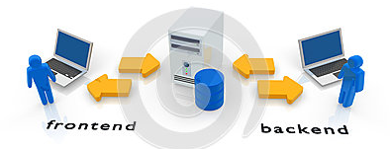



Front-End to Back-End Implementation
Why this Use-case ?
More Creativity Involved
Challenging
Scope for variety of technologies

Slide 6
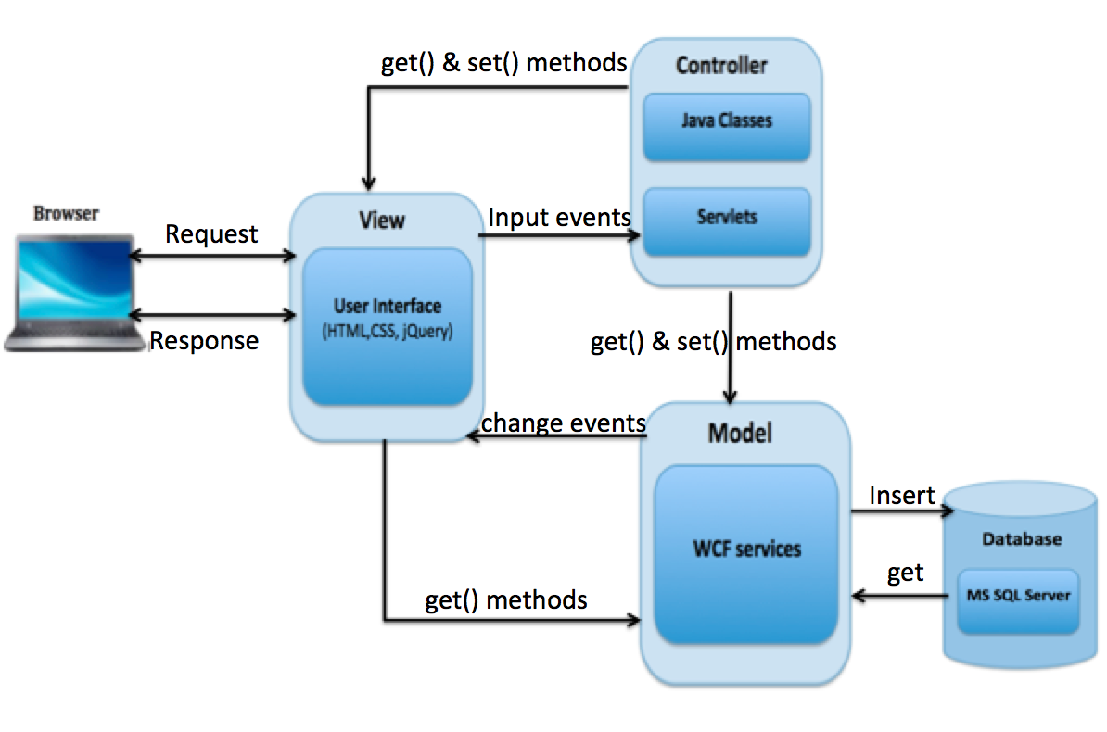
SYSTEM ARCHITECTURE

Slide 7
APPROACH FOR APPLICATION DEVELOPMENT
Requirements Gathering:
This is about making sure we understand the challenges what exactly the use case is and what the company wants from our application.
Visual Design:
We used the information gathered in requirement phase and developed the look and feel of website.
Site Architecture
This is about thinking through the structure of the site from the user’s point of view to produce a definitive site map.
Development:
This includes the development of the functioning application.
Testing:
Once the application is completely programmed, we tested to make sure everything is designed and functioning properly.

Slide 8
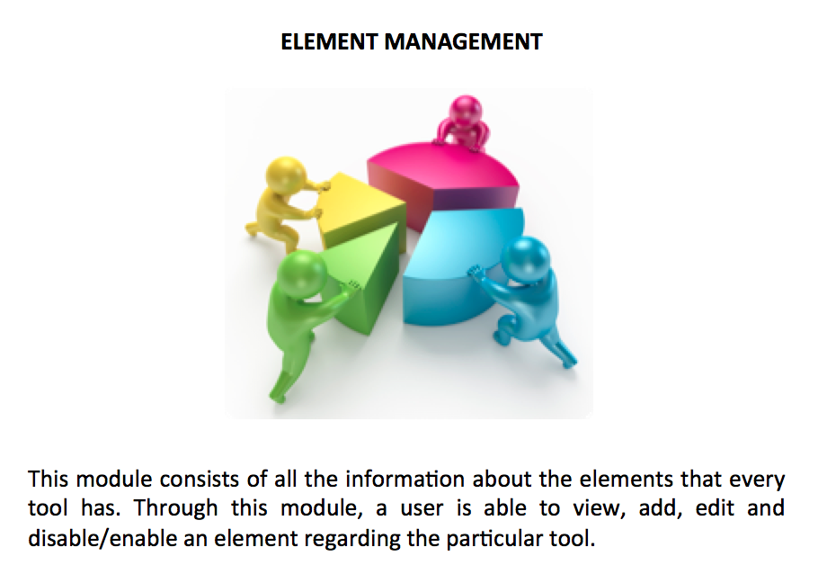
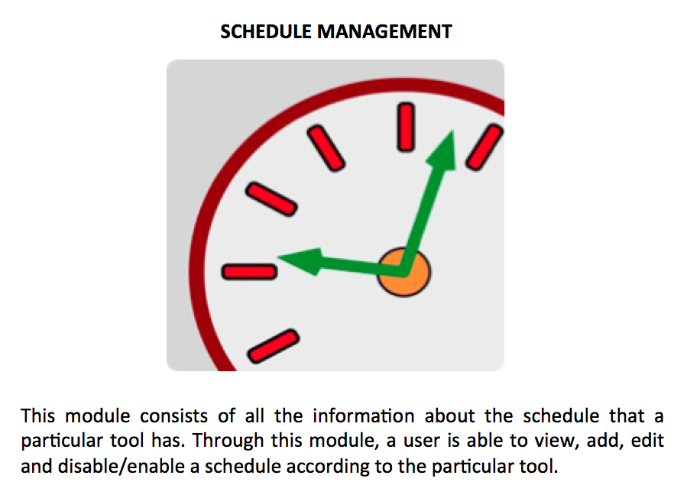
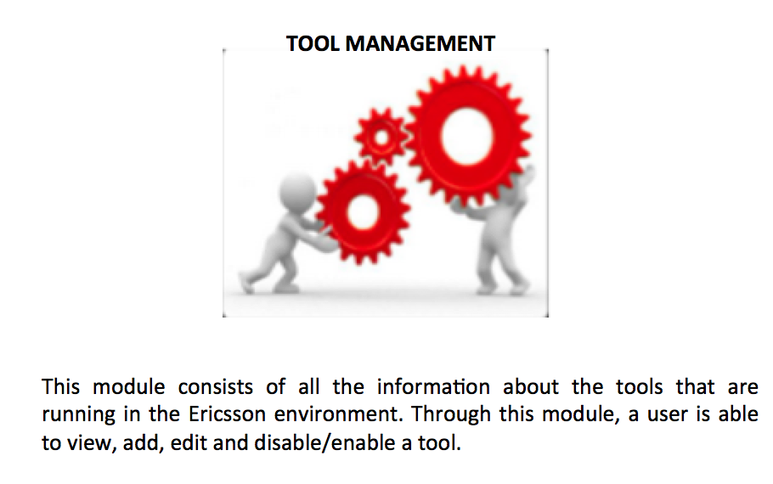
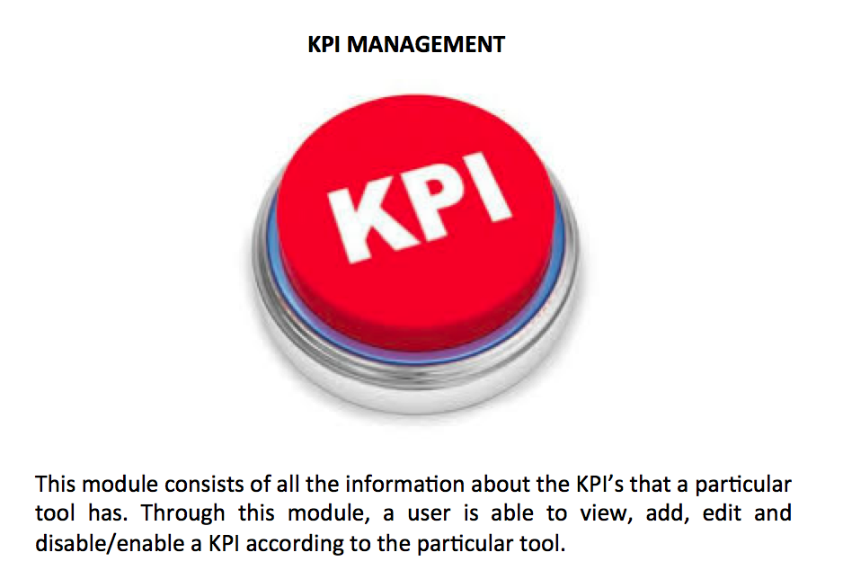
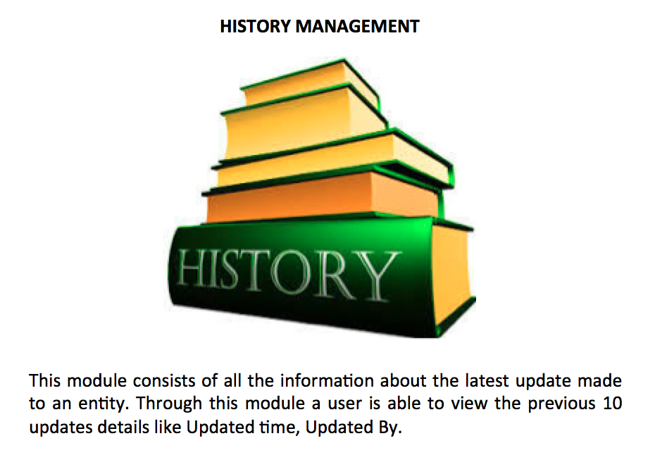
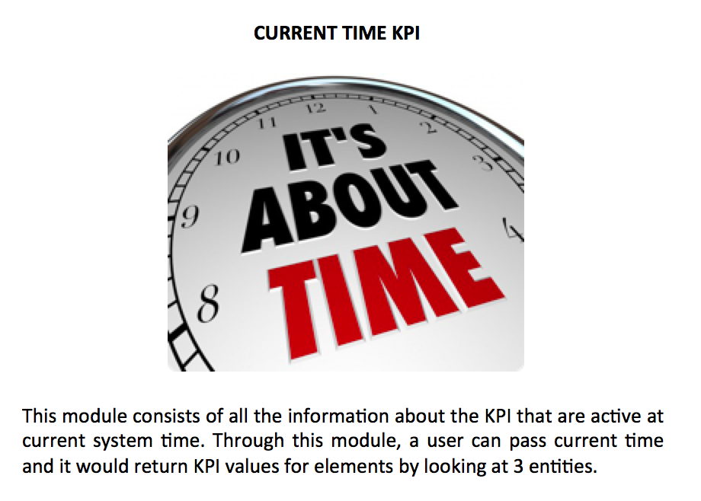
SYSTEM MODULES
In our system NTH, we have created a dashboard with 6 modules as follows:

Slide 9

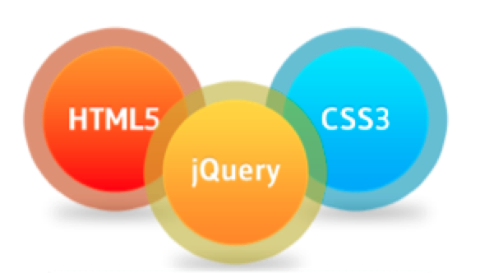




Programming Language
User Interface
TECHNOLOGIES USED
Database
Request/Response
Scripting Language
Programming Language

Slide 10

IMPLEMENTED SCHEDULING ALGORITHM
Sort schedule by end_time
For each schedule i = (1 to n)
{
if (schedule(i-1).end_time < schedule(i).start_time
{
// Go to next Iteration
}
else
{
return “schedule not valid”;
}
}
return “schedule is valid”;
Complexity of algorithm: O(n)

Slide 11

STEPS INVOLVED IN CALCULATION OF CURRENT TIME KPI
Step 1) Get_CurrentUTC_Time()
Step 2) For each timeZone in elementTable convert UTC to specific timeZone time
Step 3) Get_schedules from scheduleTable
Step 4) For each timeZone time get schedule in which that time falls
Step 5) For each schedule get KPI values from KPI table

Slide 12
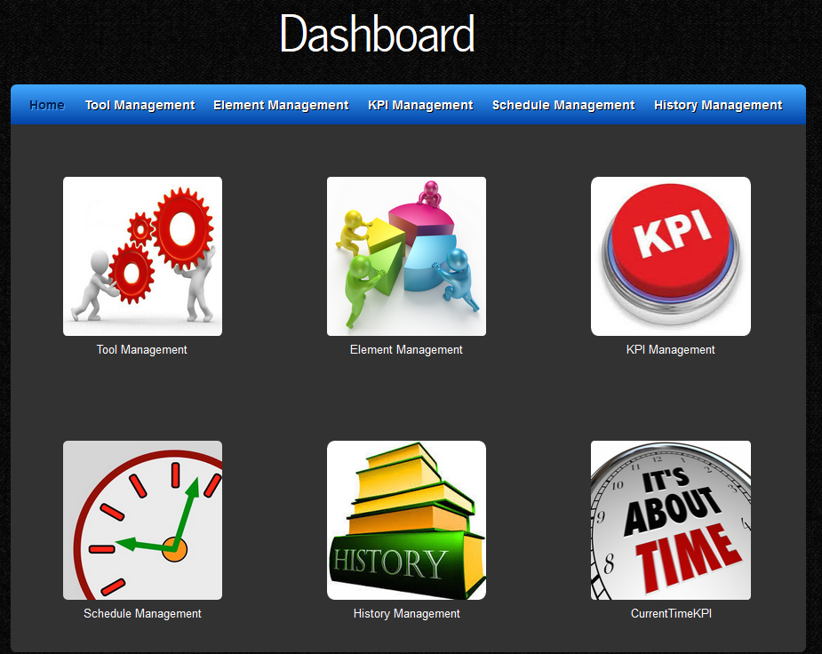
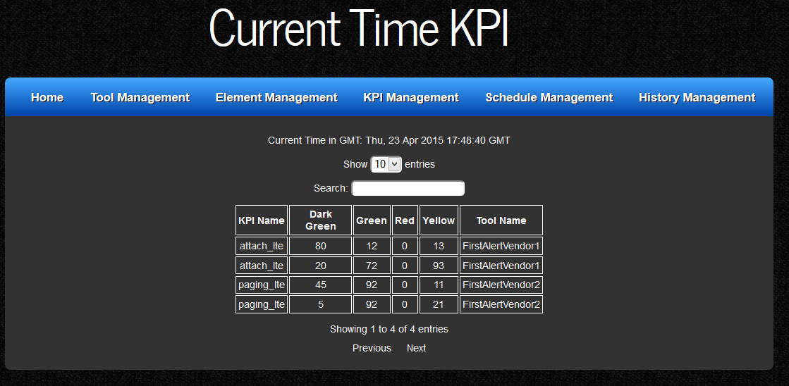
SOME INTRESTING SCREENSHOTS

Slide 13


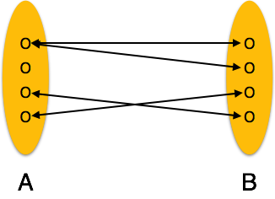
FUTURE IMPROVEMENTS
In future we need to integrate our application with real time tools and data.
Currently we have one to one mapping between Tools and elements. In future we should be able to map multiple tools with same element.
In future, system should be to able to map elements based on time zone on Google maps.

Slide 14


IMPORTANT LINKS
https://www.youtube.com/watch?v=ZFf5SoTIJIc
https://github.com/gannavarapu/Hackthon

Slide 15

WHAT MADE THIS POSSIBLE ?
“TEAM WORK”

Slide 16
REFERENCES
http://www.w3schools.com/
http://www.mkyong.com/java/java-convert-date-and-time-between-timezone/
https://msdn.microsoft.com/en-us/library/bb552363%28v=vs.110%29.aspx
http://stackoverflow.com/questions/11981282/convert-json-to-datatable

Slide 17


